Slide 1
CS 150B – Welcome and Introduction
Culture and Coding: Python (GT-AH3)

Slide 2
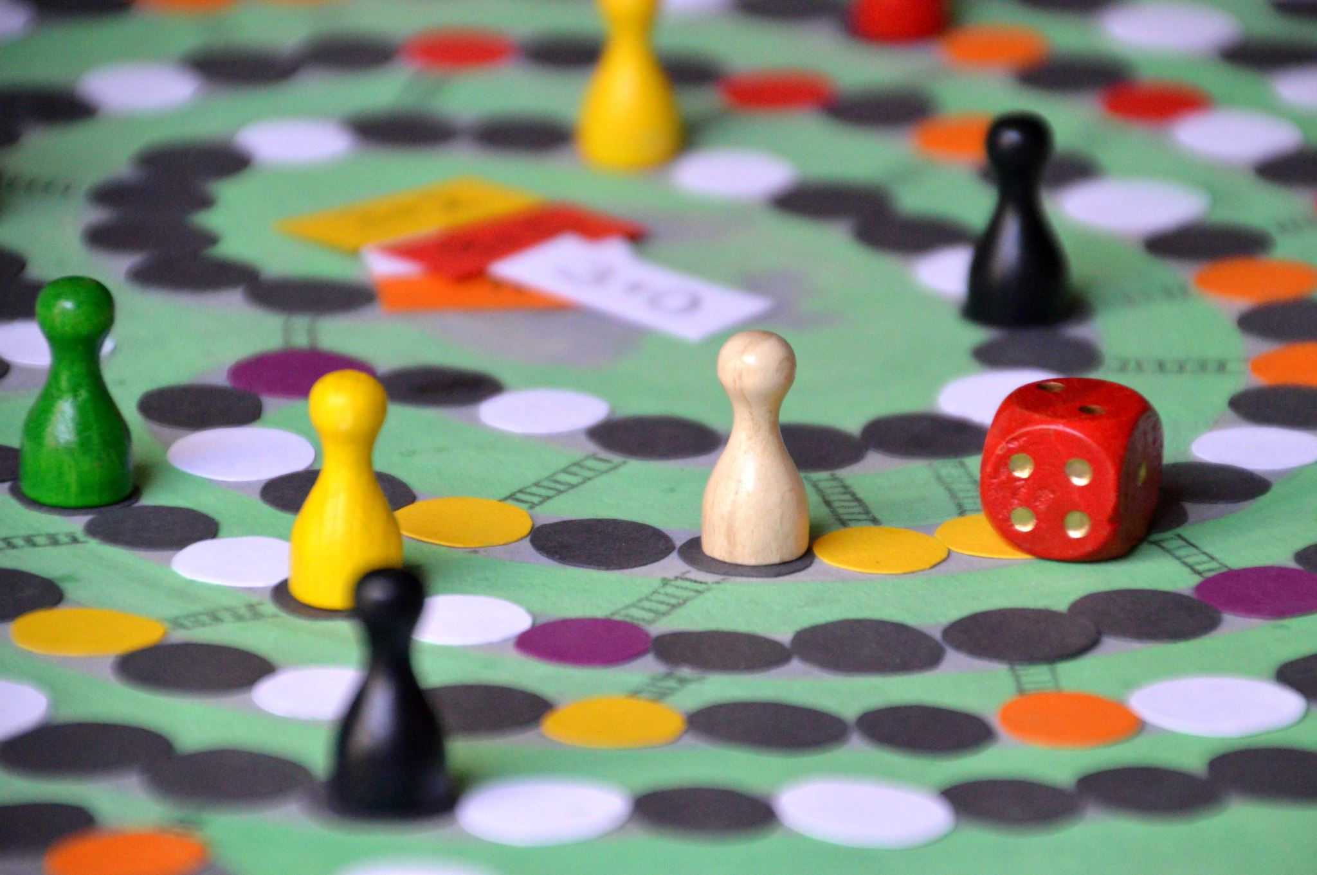
Weekly Announcements!
TODO Reminders:
Setup MS Teams
Reading 1 (Zybooks)
Syllabus Quiz
Knowledge Check
Will have these up every week!
Start of every class as you come to class.
ACM / ACM-W - Welcome Back Boardgames!
Pinon Hall 131 (the study area)
Thursday (26th) 5:30 PM
A super popular event, great way to meet others in the major, and have fun!

Slide 3
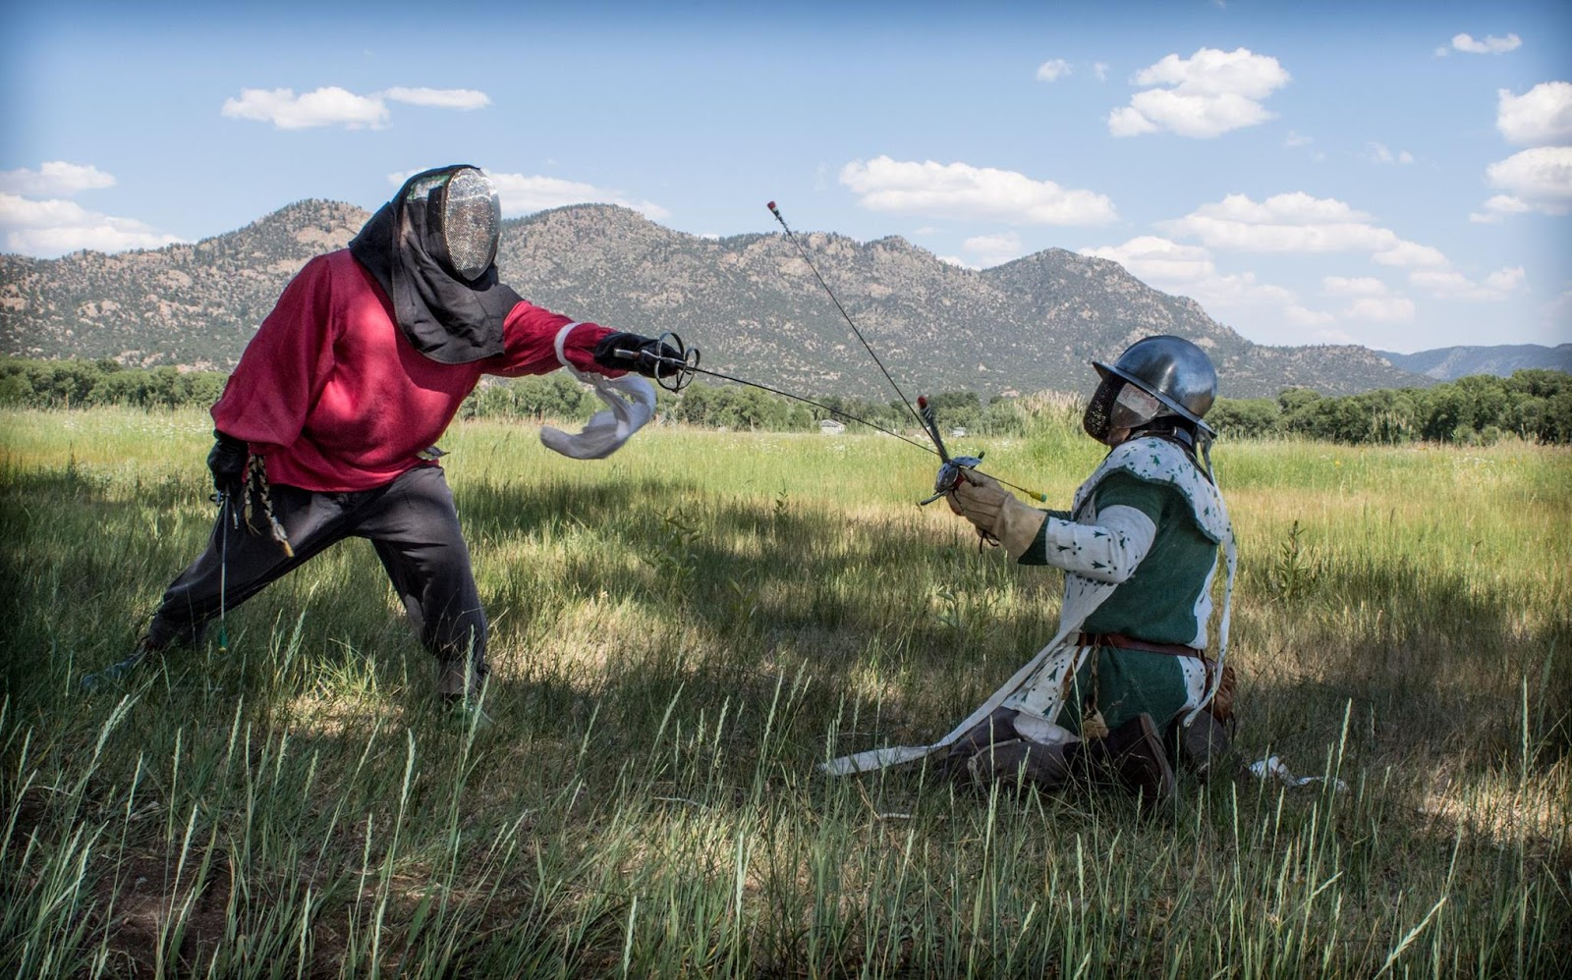
Instructor: Who Am I?
Masters of Science in Computer Science - From CSU!
Studied Computer Vision: Merging of Artificial Intelligence and Computer Graphics
PhD Candidate CSU
Worked in Industry for 10 years
Raytheon IIS
US Soil - co-owner
Real Food and Health Magazine - co-owner
Principal of an alternative high-school
Research Interests
Computer Science Education
Learning Analytics
Diversity in Computer Science
Outside Interests
Society of Creative Anachronism (Living History Recreators)
Rapier and Longsword - Historical Martial Arts (I learn and teach)
Dancing and Theater

Slide 4
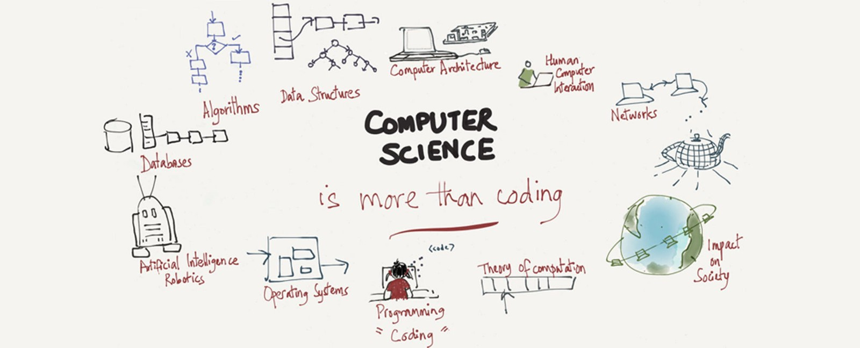
CS 150B: Topics Covered
CS For All
History of Computer Science
Inclusive Design Choices
Ethical Questions of Technology
Computer Security and Privacy
Current Industries in Computer Science
Programming Basics (Python):
Python basics (variables, operations, printing)
Control Structures (Conditionals, Loops, Functions)
Lists and Dictionaries
File I/O including CSV files
Not in this order - iterative approach
Why Python?
Used in all fields for scripting and research
Ref: Illustration by Melissa Risteff
Further Reading: https://www.geeksforgeeks.org/why-you-should-learn-python-in-2021/

Slide 5
Teaching Approach/Concepts
To have another language is to possess a second soul. - Charlemagne (748 –814)
Based on Psychology of Learning
Spacing
Interweaving
Practiced Recall
Elaboration
Reflection
Spacing and Interweaving
4 week cycles on labs and readings
Practiced Recall
Weekly Knowledge Checks
Elaboration and Reflection
Written assignments
You are learning
A new language
A different way of thinking (Divide-Conquer-Glue)
OK to struggle!

Slide 6
Course Structure - Follow Canvas
Readings
Due before Lectures, writing code
Lectures
Broken up into chunks
Labs
Meant to be done after lecture content
Coding/writing code
Writings
Written assignments
Focus on writing for research
Practical Project – Last Unit of the Course
Brings it all together
Both code and writing
Overall - a lot of little assignments!
Most Coding Assignments
Monday
Wednesdays
Written Papers
Every 3rd Thursday

Slide 7
Accommodations Window
Flexible Resubmission Windows with a *very hard* deadline
Formative Assessments
Purpose - learning should not punish, these are to guide your learning
Readings, Labs, Knowledge Checks
Can be resubmitted all semester
Written Assignments
Accommodation's window – 3 days after expected due date (hard deadline)
After graded, can be resubmitted after meeting with TA or Instructor
Summative Assessments
Purpose – Demonstrate what you know
Single submission attempt, with 3-day accommodation windows
Exams (midterm, final)
Practical Project – Written Paper and Code (code has multiple submissions)
Final Reflection

Slide 8
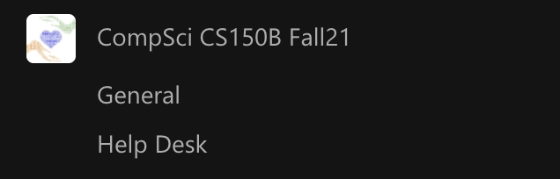
MS Teams (Mixed on-campus and online)
Starting Week 2
Help Desk Channel:
TAs will “open” the helpdesk with an announcement
Meant for coding questions (labs / homework, readings)
Don’t post code, instead post “I have a question”.
Visit the website for times! http://www.cs.colostate.edu/~cs150b
Make sure you follow the procedures.
General Chat Channel:
Great place to ask questions.
Questions should be theory or general, no code.
Perfect for asking knowledge check questions!
Your Private Study Group Channel:
Still no code – but use this for video chat with other members of your study group
Talk with each other
Help each other out!

Slide 9
Key Points
Keep with the recommended course pace!
It is very difficult to catch up. Don’t be that person.
The goal of the flexibility
Allows you to *go back* to make sure you learn it
Remember, you can’t progress content unless you submit!
Best way to study?
Knowledge checks but go back!
Psychology!
 | ReStudy | ReTesting
Massed
Spaced
Most
People
Ideal For
Recall

Slide 10
Coding is Like Music
To be successful in CS 150B
Work ahead of the schedule
Go through the modules
Practice often (daily)
Get help when you are stuck
Keep practicing
Memorization
Won’t help you! (maybe on culture topics)
You can’t memorize problem solving
You have to practice Divide-Conquer-Glue

Slide 11
Six Laws of Technology
We will come back to these all semester

Slide 12
Technology is Human
A lady came up to the great violinist Fritz Kreisler after a concert and gushed, “Maestro, your violin makes such beautiful music.” Kreisler held his violin up to his ear and said, “I don’t hear any music coming out of it.”
You see, the instrument, the hardware, the violin itself, was of no use without the human element. But then again, without the instrument, Kreisler would not have been able to make music. - Dr. Melvin Kranzberg

Slide 13
Six “Laws of Technology”
by Melvin Kranzberg
Technology is neither good nor bad; nor is it neutral.
Tech companies should try to anticipate how their tech can be used
Should they even try? Do they have a social responsibility?
Invention is the mother of necessity.
Tech adds to tech.
Technology comes in packages, big and small.
From the nuclear bomb to the smart watch
Although technology might be a prime element in many public issues, nontechnical factors take precedence in technology-policy decisions.
Corollary - people who do not know about tech, make the laws about tech - unless we intervene
All history is relevant, but the history of technology is the most relevant.
As tech leads to tech
Technology is a very human activity.
Additional Reading: 6 Laws of Tech, 6 Laws of Tech Story and Metaphor

Slide 14
And who was the first programmer?

Slide 15

The Right Honourable
Countess of Lovelace
Photo By:
Alfred Edward Chalon [Public domain], via Wikimedia Commons

